Slide 1







DBMS Lab
Introduction

Slide 2
Things we will complete today
1. Database Software Installation
2. Loading a Sample database
3. Run basic SQL query on loaded database
4. Learn about some additional tools

Slide 3
Installation

Slide 4
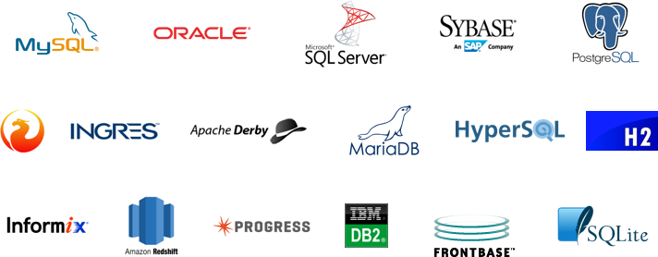
1. Database Software Installation

Slide 5
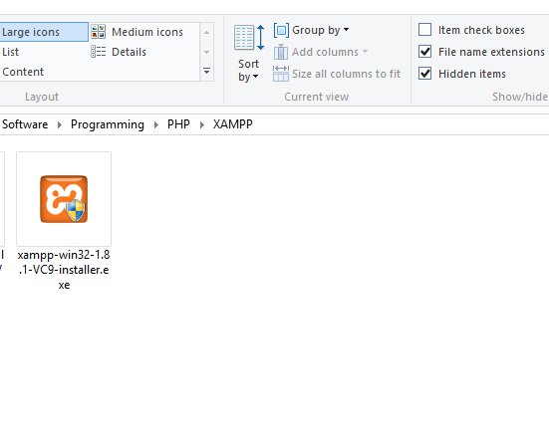
1. Database Software Installation

Slide 6
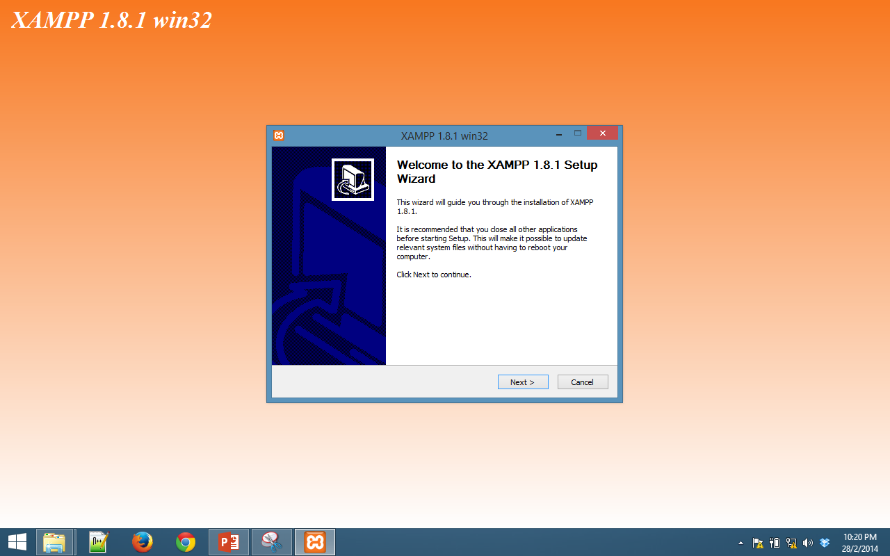
1. Database Software Installation

Slide 7
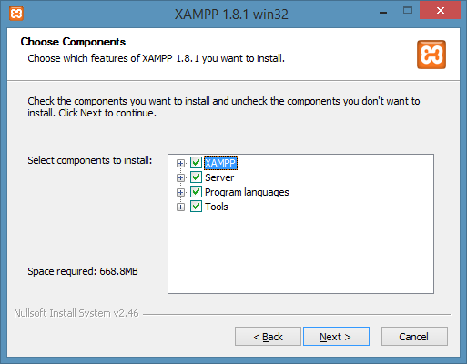
1. Database Software Installation

Slide 8
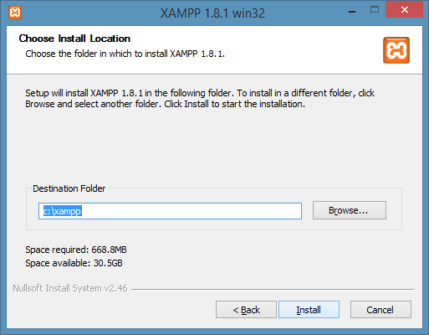
1. Database Software Installation

Slide 9
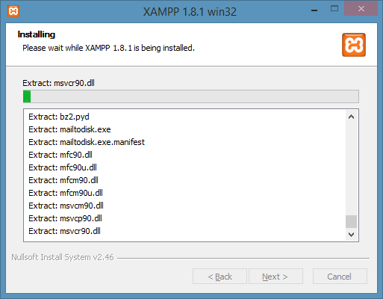
1. Database Software Installation

Slide 10
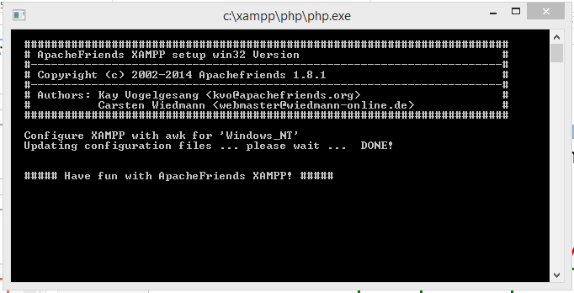
1. Database Software Installation

Slide 11
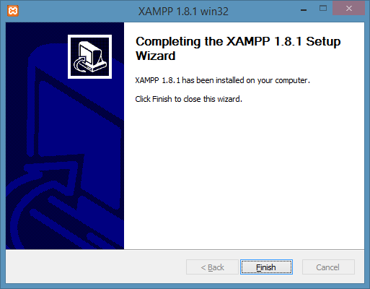
1. Database Software Installation

Slide 12
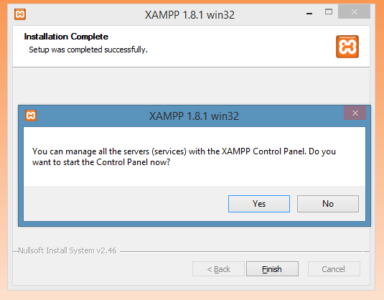
1. Database Software Installation

Slide 13
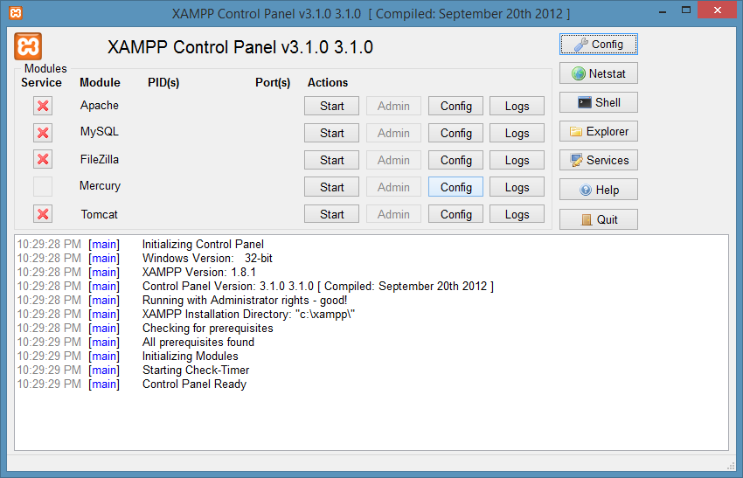
1. Database Software Installation

Slide 14
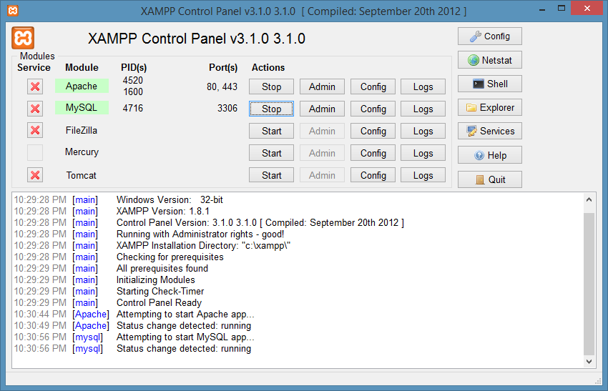
1. Database Software Installation

Slide 15
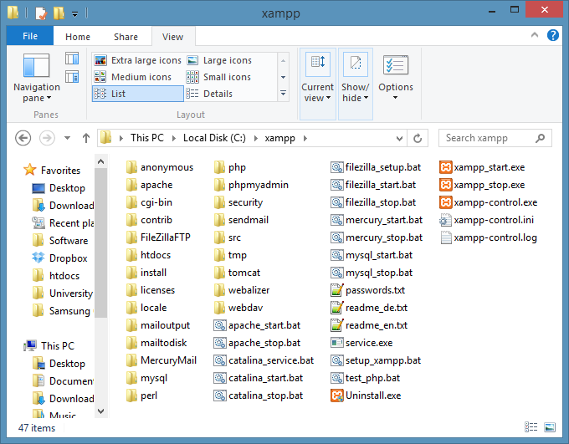

1. Database Software Installation

Slide 16
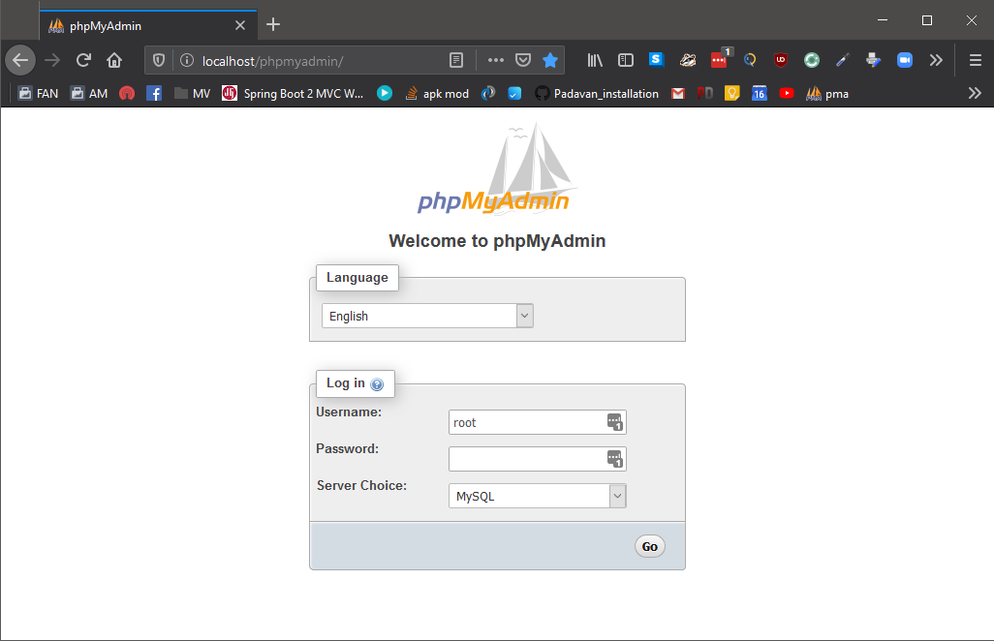
1. Database Software Installation
http://localhost/phpmyadmin

Slide 17
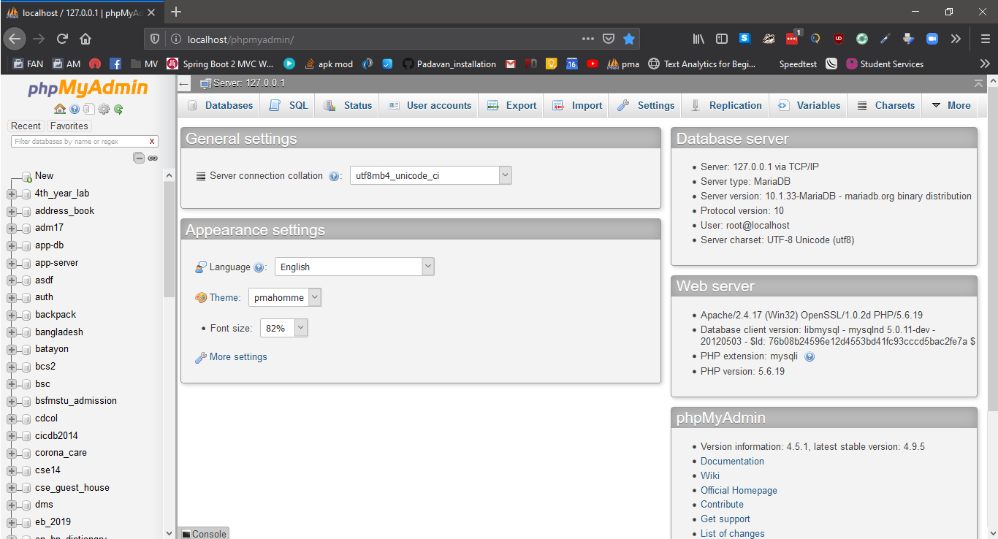
1. Database Software Installation
http://localhost/phpmyadmin

Slide 18
1. Database Software Installation
http://localhost/phpmyadmin

Slide 19
Loading Sample Database
Demo

Slide 20
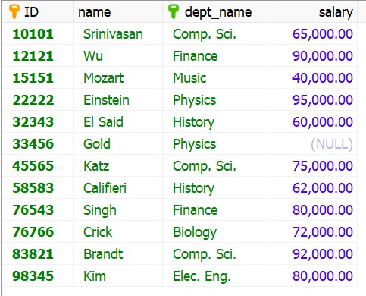
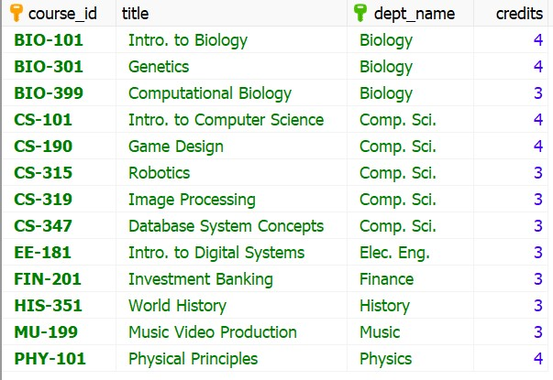
Loading Sample Database
Table: Instructor
Table: Course
http://localhost/phpmyadmin

Slide 21
Run basic SQL query
Demo

Slide 22
SQL
Structures Query Language
developed at IBM by Donald D. Chamberlin and Raymond F. Boyce for their database software “System R” in 1970
Oracle made it popular.
By 1986, ANSI and ISO officially adopted the SQL and standard Language for RDBMS.

Slide 23
SQL

Slide 24
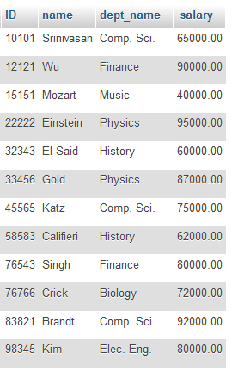
Basic SQL Query
For getting all data from a specific table
SELECT * FROM <table_name>
SELECT * FROM instructor

Slide 25
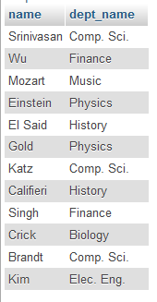
Basic SQL Query
Showing only selected fields
SELECT
field1,fiel2,…fieldn
FROM
<table_name>
SELECT name, dept_name FROM instructor

Slide 26
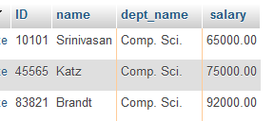
Basic SQL Query
Filtering data based on condition
SELECT
field1,fiel2,…fieldn
FROM
<table_name>
WHERE
<condition>
SELECT * FROM instructor
WHERE dept_name=‘Comp. Sci.’

Slide 27
Some Additional Tools

Slide 28
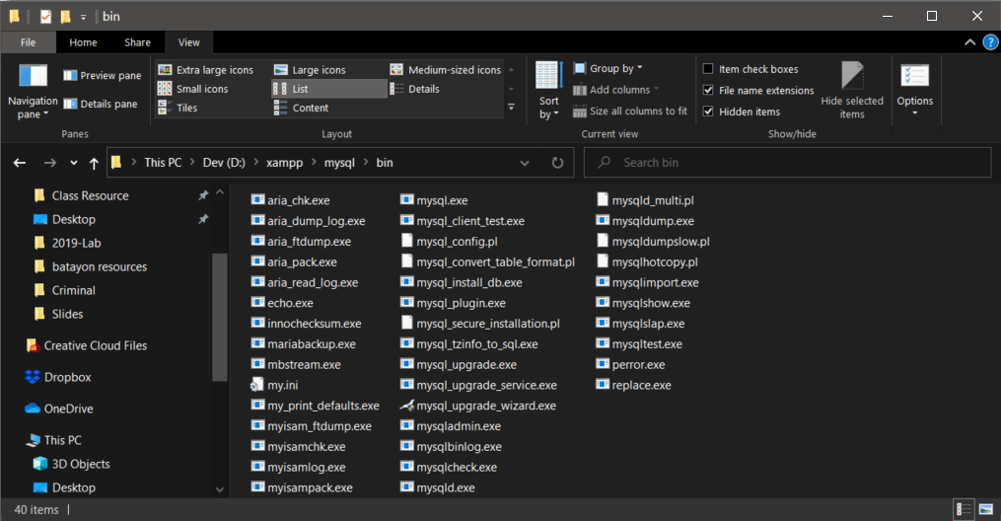
5. Locate mysql within XAMPP
C:\xampp\bin\mysql\bin

Slide 29
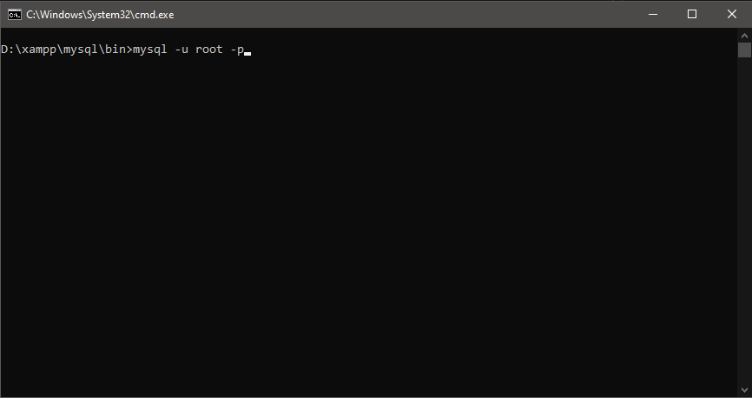
6. Using command prompt run mysql
mysql –u root -p

Slide 30
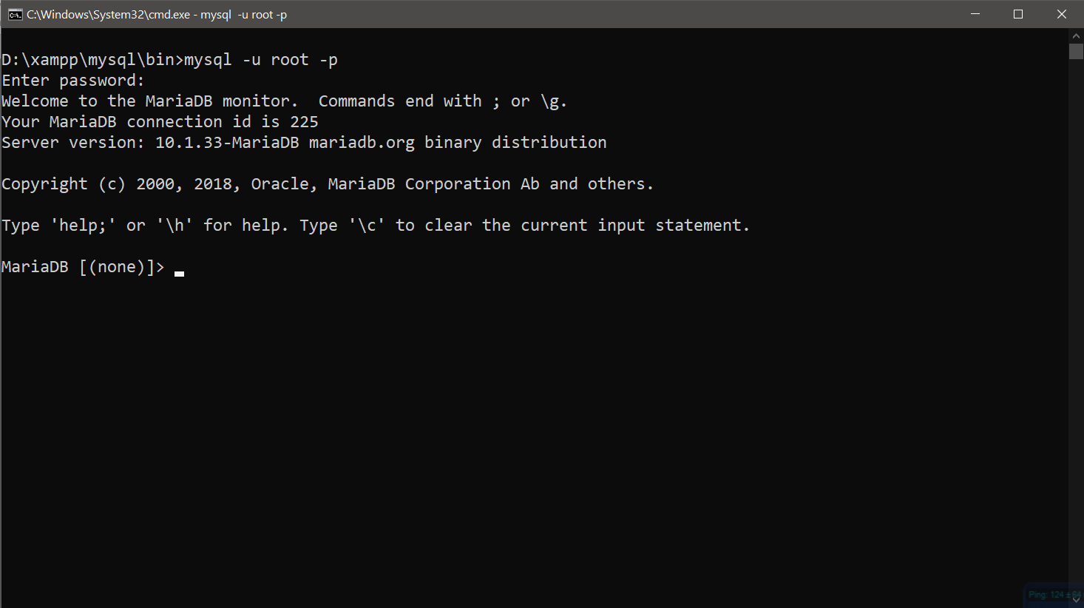
6. Using command prompt run mysql
mysql –u root -p

Slide 31
7. Run some query on the db server
Show available databases
Open a database
Show tables on opened database
show databases;
use <database_name>;
show tables;

Slide 32
7. Run some query on the db server
Show schema of a table
Show records from a database
describe <table_name>;
desc <table_name>;
←short form
select * from <table_name>;

Slide 33
7. Run some query on the db server
show databases;
use <database_name>;
show tables;
←short form
describe <table_name>;
desc <table_name>;
select * from <table_name>;

Slide 34
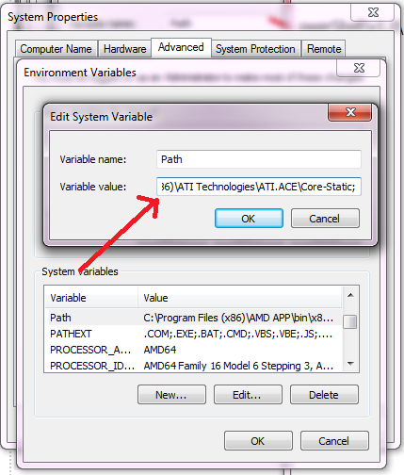
8. Add mysql to windows env path for easy access
Add your mysql path
c:\wamp\bin\mysql\mysql###\bin;
At the end of the Variable value
Test if everithing is OK
Open comand prompt anywhere and type
“mysql“
Without the quotation mark

Slide 35
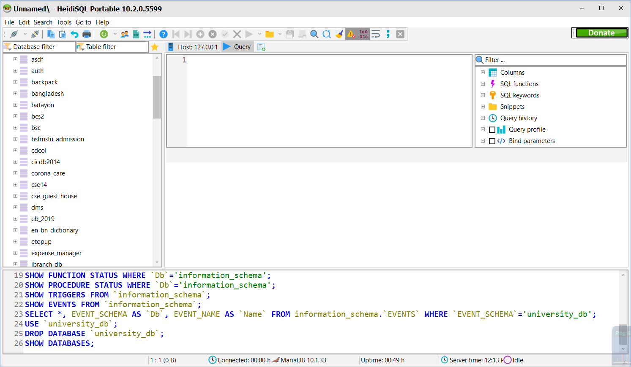
I not like mysql command prompt OR phpMyAdmin ☹
No problem !!

Slide 36
Demo.

Slide 37
End.

